Slide 1
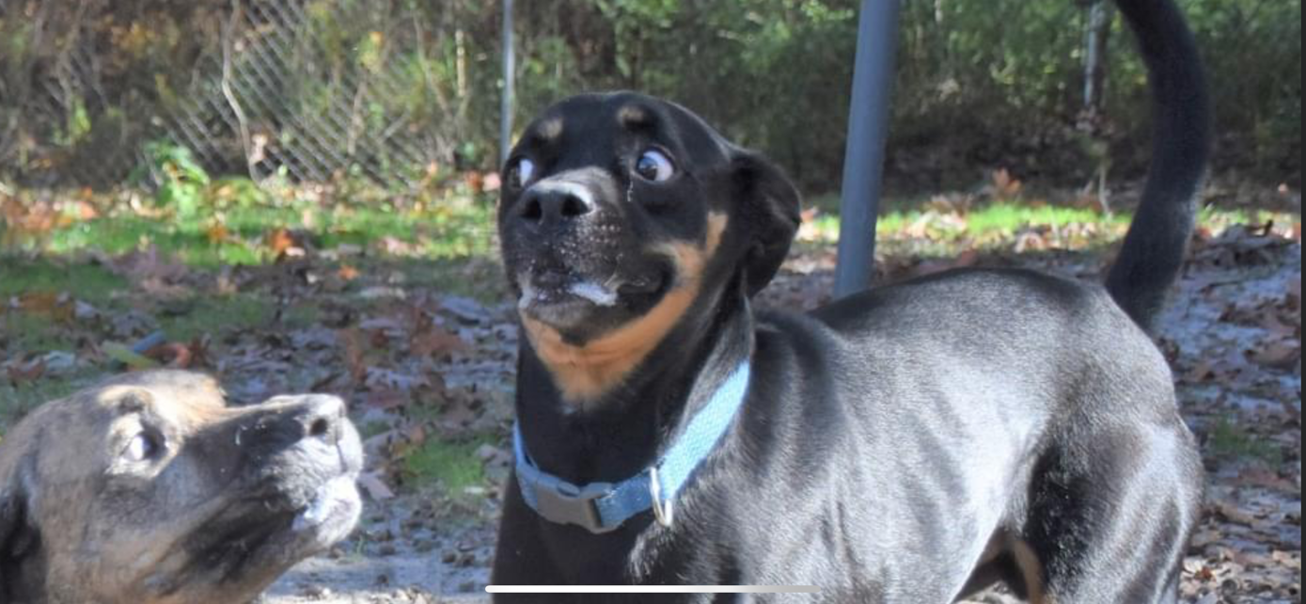
Dexxy
Dale Campbell
DSSA 5102

Slide 2
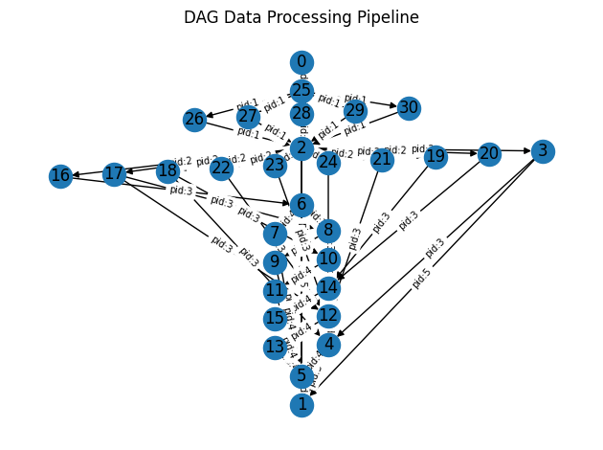
Project Objectives
Connect to dvdrental database
Extract Data
Transform Data
Load Data into data warehouse
Close connection

Slide 3
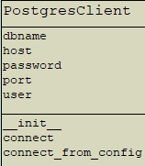
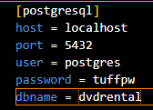
Setup
Class
Database.ini

Slide 4
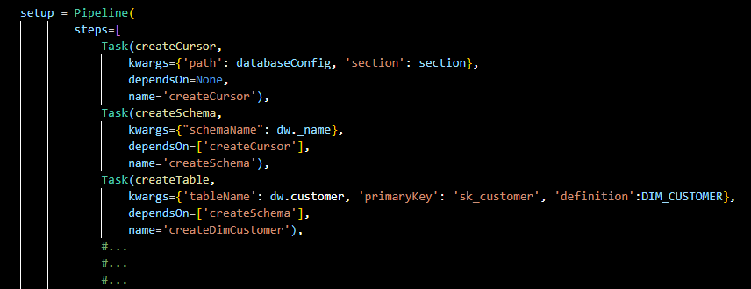
Setup Cont.
Create Schema
Create Dimension Tables
Customer
Store
Film
Staff
Dates
Create Fact Table
Rental

Slide 5
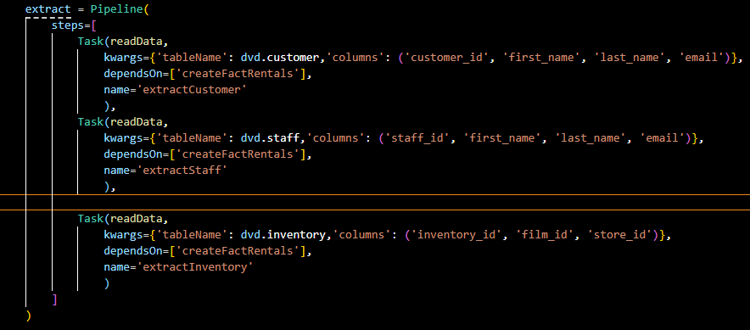
Extract
Read data from all available tables
Saves to df

Slide 6
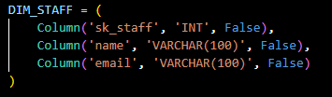
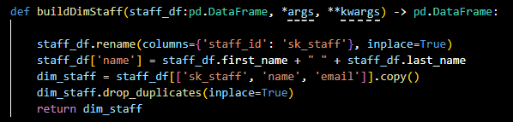
Transform
Formats dataframes to match table definitions

Slide 7
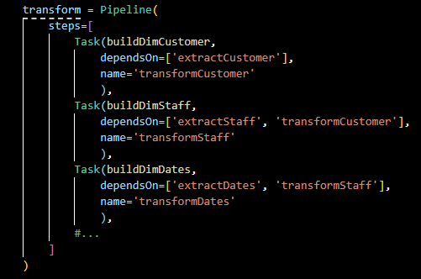
Transform Cont.
Repeats process for all tables

Slide 8
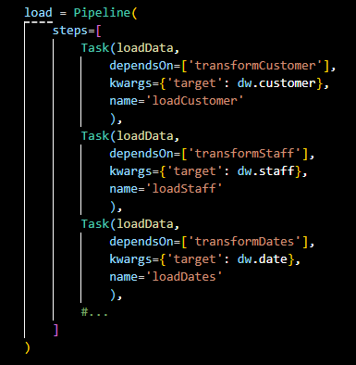
Load
Inserts the data to the data warehouse

Slide 9
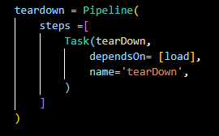
Teardown
Closes connection

Slide 10
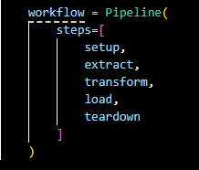
Workflow Combined

Slide 11
Limitations
Only allows for building ETL pipeline of dvdrental
Single threaded
No graphical user interface (GUI)

Slide 12
Questions?

